Slide 1
ML Visuals
By dair.ai
https://github.com/dair-ai/ml-visuals
Notes:
IMPORTANT NOTE: Please don’t request editing permission if you do not plan to add anything to the slides. If you want to edit the slides for your own purposes, just make a copy of the slides.
ML Visuals is a new collaborative effort to help the machine learning community in improving science communication by using more professional, compelling and adequate visuals and figures. You are free to use the visuals in your presentations or blog posts. You don’t need to ask permission to use any of the visuals but it will be nice if you can provide credit to the designer/author (author information found in the slide notes).
This is a project made by the dair.ai community and maintained in this GitHub repo. Our community members will continue to add more common figures and basic elements in upcoming versions. Think of this as free and open artefacts and templates which you can freely and easily download, copy, distribute, reuse and customize to your own needs. I am maintaining this set of slides on a bi-weekly basis where I will regularly organize and keep the slides clean from spam or unfinished content.
Contributing: To add your own custom figures, simply add a new slide and reuse any of the basic visual components (remember to request edit permissions). We encourage authors/designers to add their visuals here and allow others to reuse them. Make sure to include your author information (in the notes section of the slide) so that others can provide the proper credit if they use the visuals elsewhere (e.g. blog/presentations). Add your name and email just in case someone has any questions related to the figures you added. Also, provide a short description of your visual to help the user understand what it is about and how they can use it. If you need "Edit" permission, just click on the "request edit access" option under the "view only" toolbar above or send me an email at ellfae@gmail.com. If you have editing rights, please make sure not to delete any of the work that other authors have added. You can try to improve it by creating a new slide and adding that improved version (that’s actually encouraged).
Downloading a figure from any of the slides is easy. Just click on File→Download→(choose your format).
If you need help with customizing a figure or have an idea of something that could be valuable to others, we can help. Just open an issue here and we will do our best to come up with the visual. Thanks.

Slide 2
Basic ML Visuals
Notes:
Note:
Basic components go here.

Slide 3
Notes:
Note:
This is a simple round rectangle that can represent some process, operation, or transformation
Author: Elvis Saravia (ellfae@gmail.com)

Slide 4
Notes:
Note:
This can be used to represent a vector. If you want to edit the distance between each element, you can “ungroup” the shapes and then modify the distance between the individual lines.
Author: Elvis Saravia (ellfae@gmail.com)

Slide 5
Notes:
Symbolizing an embedding

Slide 6
Notes:
Note:
Can represent a neuron or some arbitrary operation
Author: Elvis Saravia (ellfae@gmail.com)

Slide 7
Notes:
Note:
These visuals can represent a multi-directional array (3D) input, tensor, etc.
Author: Elvis Saravia (ellfae@gmail.com)

Slide 8
s^{u}₁
~
~
h^{1,d}
Encoder
f_{θ}
dot product
z^{1,d}
s^{u}
Minimize
Minimize
mlp
z^{2,d}
dot product
s^{u}₂
h^{2,d}
~
~
Encoder
f_{θ}

Slide 9





i₁
i₂
i₃
i₄
i₅
i₁
i₂
i₃
i₄
i₁
i₂
i₃
i₁
i₂

Slide 10




Softmax
Convolve
Sharpen
Notes:
Note:
These visuals could represent transformations (left) or operations (right)
The visuals on the right use the Math Equations Add on for Google Slides.
If you click on the equation you are able to modify it by:
Selecting Add Ons → Math Equations → Menu
While the equation is selected, click “Connect to Equation” on the “Math Equations UI”
Then change the properties like color, size, etc.
Author: Elvis Saravia (ellfae@gmail.com)

Slide 11
$$LRec$$
Meta updating
$$S^{1}$$
$$h^{1}$$
Regular
$$S^{1}$$
$$h^{1′}$$
dot product
$$z^{1}$$
Encoder
$Lc$_{l2}
$$S^{2}$$
$$h^{2}$$
$Lc$_{l1}
$$z^{2}$$
dot product

Slide 12
Regular
Encoder

Slide 13




Softmax
Convolve
Sharpen
Notes:
Note:
These visuals could represent transformations (left) or operations (right)
The visuals on the right use the Math Equations Add on for Google Slides.
If you click on the equation you are able to modify it by:
Selecting Add Ons → Math Equations → Menu
While the equation is selected, click “Connect to Equation” on the “Math Equations UI”
Then change the properties like color, size, etc.
Author: Elvis Saravia (ellfae@gmail.com)
Log:
Added a dark theme version of the previous slide

Slide 14
Softmax
Linear
Add & Norm
Feed
Forward
Add & Norm
Add & Norm
Feed
Forward
Multi-Head
Attention
Add & Norm
Add & Norm
Multi-Head
Attention
Masked
Multi-Head
Attention
Positional
Encoding
Positional
Encoding
Input
Embedding
Output
Embedding
Inputs
Outputs(shifted right)
Notes:
Note:
Using the same visual components from before and a few new custom ones, I was able to come up with the Transformer architecture
This is a reproduction of the Transformer architecture figure presented in the work of Vaswani et al. 2017
You can further customize it however you want
Author: Elvis Saravia (ellfae@gmail.com)

Slide 15
Supervised Contrastive Learning
Unsupervised Contrastive Learning
Seq₁ Seq₁’
’
……
……
Encoder
Seq_{k} Seq_{k}’
’
’
’
’
’
’
’
……
……
Seq_{|B|} Seq_{|B|}’
’
’
’
’
’
’
’
Mini-batch Sequences
Mini-batch Sequences
User Intent Represention
Intent Prototype Represention
Positive pair:
Negative pair
’

Slide 16
Supervised Contrastive Learning
Unsupervised Contrastive Learning
Seq₁ Seq₁’
’
……
……
Encoder
Seq_{k} Seq_{k}’
’
’
’
’
’
’
’
……
……
Seq_{|B|} Seq_{|B|}’
’
’
’
’
’
’
’
Mini-batch Sequences
Mini-batch Sequences
User Intent Represention
Intent Prototype Represention
Positive pair:
Negative pair
’

Slide 17
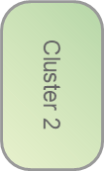
Cluster 1
mean
B*H
B*L
DuoRec
B*L*H
reshape
(B*L)*H

Slide 18
1 2 3 4 5 6
intent
target
target
intent
i_1
1 2
8 2
i_5
i_2
1 2 3
10 11 17 3
i_2
i_3
1 2 3 4
9 12 1 4
i_4
1<->8
2<->17
3<->1

Slide 19
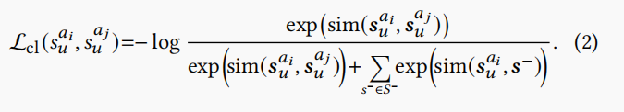
B*L
B*L*H
B*L
encoder
DA
B*L
B*L*H

Slide 20
Rec
B*L
B*L*H
Contrastive
MLP
B*L*H
DuoRec
Contrastive
B*L
B*L*H

Slide 21
Fine Encoder
Rec
B*L
B*L*H
Contrastive
B*L
B*L*H
Crose Encoder

Slide 22








Behave history
target
intent
User1
decorate
User2
gifts
User3

Slide 23



User1

Slide 24
global
gcl
B*H
B*H
multi
B*L*H
mcl
B*L
(B*L)*H
DuoRec
B*L*H
nearst
ncl
B*H
B*H

Slide 25
Rec
B*L
B*L*H
Contrastive
MLP
B*L*H
DuoRec
Contrastive
B*L
B*L*H
MLP
B*L*H
Contrastive

Slide 26
Rec
B*L
MLP
B*L*H
B*L*H
Embedding
DuoRec
Contrastive
B*L
MLP
B*L*H
B*L*H

Slide 27
global
gcl
B*H
B*H
multi
mcl
B*L
(B*L)*H
B*L*H
DuoRec
B*L*H
nearst
ncl
B*H
B*H

Slide 28
B*L
B*L*H
B*L*H
MLP
CL4SRec
Contrastive
Contrastive
Contrastive
B*L
B*L*H
MLP
B*L*H

Slide 29
B*L
SASRec
B*L*H
Rec Loss
mean
quary
Cluster 1
B*H
CL1
B*H
CL2
B*L*H
mean
DA
SASRec
B*L*H
CL1
mean
CL3
B*H

Slide 30
B*L
SASRec
B*L*H
Rec Loss
g、m、n
quary
Cluster 1
B*H
CL1
B*H
CL2
B*L*H
m、g、n
SASRec
B*L
B*L*H
CL1
CL3
m、n、g
B*H

Slide 31
B*L
SASRec
B*L*H
Rec Loss
mean
reshape
B*L*H
quary
quary
Cluster 1
Cluster 2
B*H
(B*L)*H
reshape
B*L*H
CL1
B*H
CL2
B*L*H
mean
A
DA
A
CL3
SASRec
A
CL3
B*L*H
CL1
mean
B*H
CL2

Slide 32
CL1
B*H
CL2
B*L*H
mean
DA
A
CL3
SASRec
A
CL3
B*L*H
CL1
mean
B*H
CL2
A:
1.B*(L*H)
2.L*H
3.B*L
0···1,2,3,5,6,9,10
a,···,c,d,d,c,e,h,j

Slide 33
Softmax
Linear
Add & Norm
Feed
Forward
Add & Norm
Add & Norm
Multi-Head
Attention
Feed
Forward
Add & Norm
Add & Norm
Masked
Multi-Head
Attention
Multi-Head
Attention
Positional
Encoding
Positional
Encoding
Input
Embedding
Output
Embedding
Inputs
Outputs (shifted right)
Notes:
Note:
Using the same visual components from before and a few new custom ones, I was able to come up with the Transformer architecture
This is a reproduction of the Transformer architecture figure presented in the work of Vaswani et al. 2017
You can further customize it however you want
Author: Elvis Saravia (ellfae@gmail.com)

Slide 34
I
love
coding
and
writing
Tokenize
“I love coding and writing”
Notes:
Note:
This figure aims to demonstrate the process of tokenization
If you want to change the gradient colors of this shape, you can simply click on the shape and then select “Fill color” (the bucket looking icon at the top).
This is a gradient color so you can customize however you want
Author: Elvis Saravia (ellfae@gmail.com)

Slide 35
Hidden Layers
Input Layer
a^{[1]}₁
a^{[2]}₁
a^{[3]}₁
Output Layer
a^{[1]}₂
a^{[2]}₂
a^{[3]}₂
a^{[4]}
Ŷ
X
a^{[1]}₃
a^{[2]}₃
a^{[3]}₃
a^{[1]}_{n}
a^{[2]}_{n}
a^{[3]}_{n}
X = A^{[0]}
A^{[1]}
A^{[2]}
A^{[3]}
A^{[4]}
Notes:
Created By @srvmshr
sourav@yahoo.com

Slide 36
Hidden Layers
Input Layer
a^{[1]}₁
a^{[2]}₁
a^{[3]}₁
Output Layer
a^{[1]}₂
a^{[2]}₂
a^{[3]}₂
a^{[4]}
Ŷ
X
a^{[1]}₃
a^{[2]}₃
a^{[3]}₃
a^{[1]}_{n}
a^{[2]}_{n}
a^{[3]}_{n}
X = A^{[0]}
A^{[4]}
A^{[1]}
A^{[2]}
A^{[3]}
Notes:
Original by @srvmshr
sourav@yahoo.com
Dark themed version by (Elvis Saravia - ellfae@gmail.com)

Slide 37
Hidden Layers
Input Layer
^{[1}a]₁
a^{[2]}₁
a^{[3]}₁
Output Layer
a^{[1]}₂
a^{[2]}₂
a^{[3]}₂
a^{[4]}
Ŷ
X
a^{[1]}₃
a^{[2]}₃
a^{[3]}₃
a^{[1]}_{n}
a^{[2]}_{n}
a^{[3]}_{n}
X = A^{[0]}
A^{[1]}
A^{[2]}
A^{[3]}
A^{[4]}
Notes:
Created By @srvmshr
sourav@yahoo.com

Slide 38
CONV operation
MxM
ReLU
+b1
+b1
MxMX2
+b2
+b2
NxNx3
MxM
ReLU
a^{[l-1]}
a^{[l]}
Notes:
Added by @srvmshr
Sourav @ yahoo.com

Slide 39
CONV operation
MxM
ReLU
+b1
+b1
MxMX2
+b2
+b2
NxNx3
MxM
ReLU
Notes:
Added by @srvmshr
Sourav @ yahoo.com

Slide 40
CONV operation
MxM
ReLU
+b1
+b1
MxMX2
+b2
+b2
NxNx3
MxM
ReLU
Notes:
Added by @srvmshr
Sourav @ yahoo.com

Slide 41
Abstract backgrounds
Notes:
Note:
You can add abstract backgrounds here

Slide 42
Notes:
Note:
You can change the gradient of each component
Author: Elvis Saravia

Slide 43
DAIR.AI
Notes:
Note:
This is the header I use for the dair.ai NLP Newsletter
You can change the gradient of each component
You can customize the background as well by right clicking and changing to another gradient or static color
Author: Elvis Saravia

Slide 44
Notes:
Note:
This is the header I use for the dair.ai NLP Newsletter
You can change the gradient of each component
Author: Elvis Saravia

Slide 45
Notes:
Note:
This is the header I use for the dair.ai NLP Newsletter
You can change the gradient of each component
Author: Elvis Saravia

Slide 46
Gradient Backgrounds
Notes:
Note:
Gradient background shows some inspirations and ideas for color themes that could be used for backgrounds
The examples used in this section are inspired by https://uigradients.com

Slide 50
Community Contributions
Notes:
Note:
You can add abstract backgrounds here

Slide 51
SM
FC
L
L
L
L
L
L
L
L
L
L
C
C
C
C
C
C
C
C
C
C

Slide 52
SM
FC
Conv
C
C
C
C
C
C
C
C
C
C

Slide 53
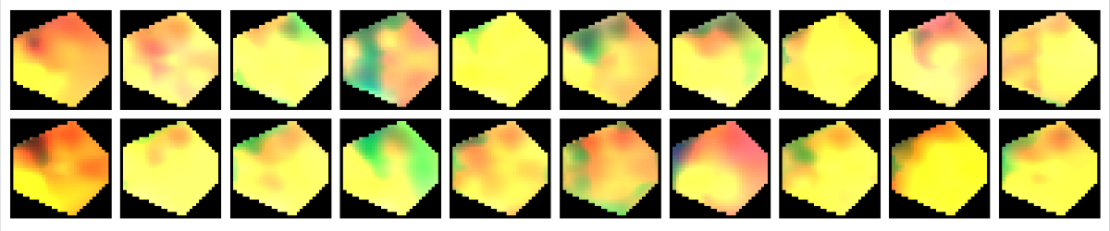
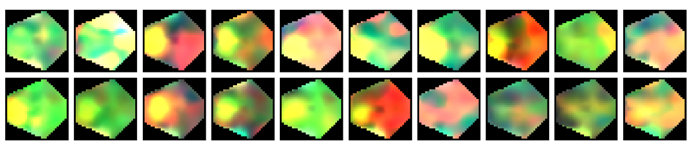
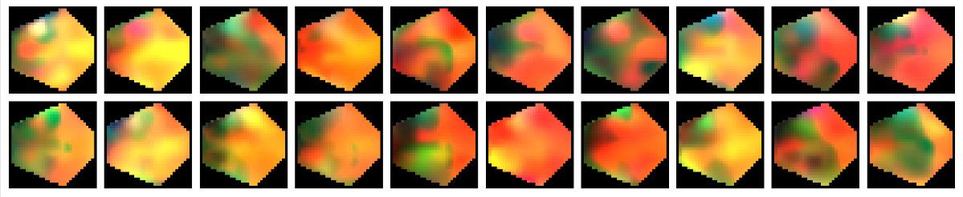
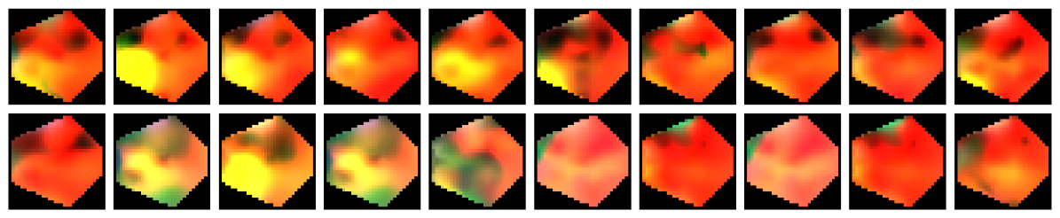
Sample1
Level 1
Sample2
Sample1
Level 2
Sample2
Sample1
Level 3
Sample2
Sample1
Level 4
Sample2
Frame1
Frame2
Frame3
Frame4
Frame5
Frame6
Frame7
Frame8
Frame9
Frame10

Slide 54
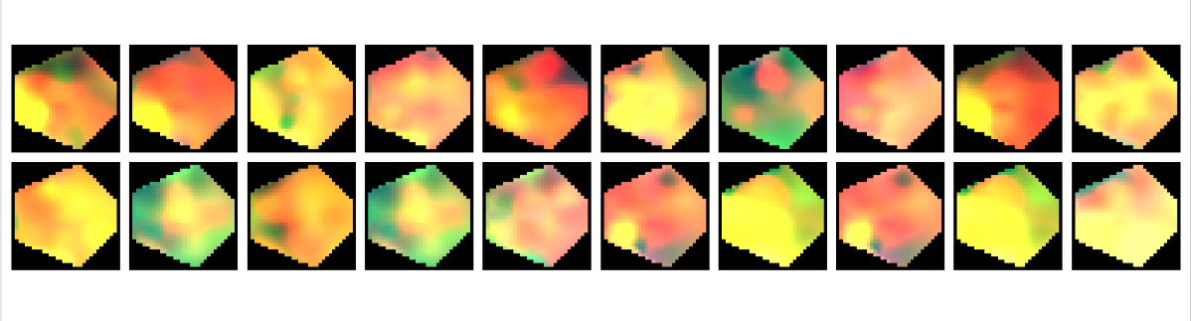
S7
S8
Frame1
Frame2
Frame3
Frame4
Frame5
Frame6
Frame7
Frame8
Frame9
Frame10

Slide 55
S7
S8
Frame1
Frame2
Frame3
Frame4
Frame5
Frame6
Frame7
Frame8
Frame9
Frame10
(a) Inter-Subject Variations
Sample1
Level 1
Sample2
Sample1
Level 2
Sample2
Sample1
Level 3
Sample2
Sample1
Level 4
Sample2
Frame1
Frame2
Frame3
Frame4
Frame5
Frame6
Frame7
Frame8
Frame9
Frame10
(b) Intra-Subject Variations

Slide 56
S7
S8
Frame1
Frame2
Frame3
Frame4
Frame5
Frame6
Frame7
Frame8
Frame9
Frame10
Sample1
Level 1
Sample2
Sample1
Level 2
Sample2
Sample1
Level 3
Sample2
Sample1
Level 4
Sample2
Frame1
Frame2
Frame3
Frame4
Frame5
Frame6
Frame7
Frame8
Frame9
Frame10

Slide 57
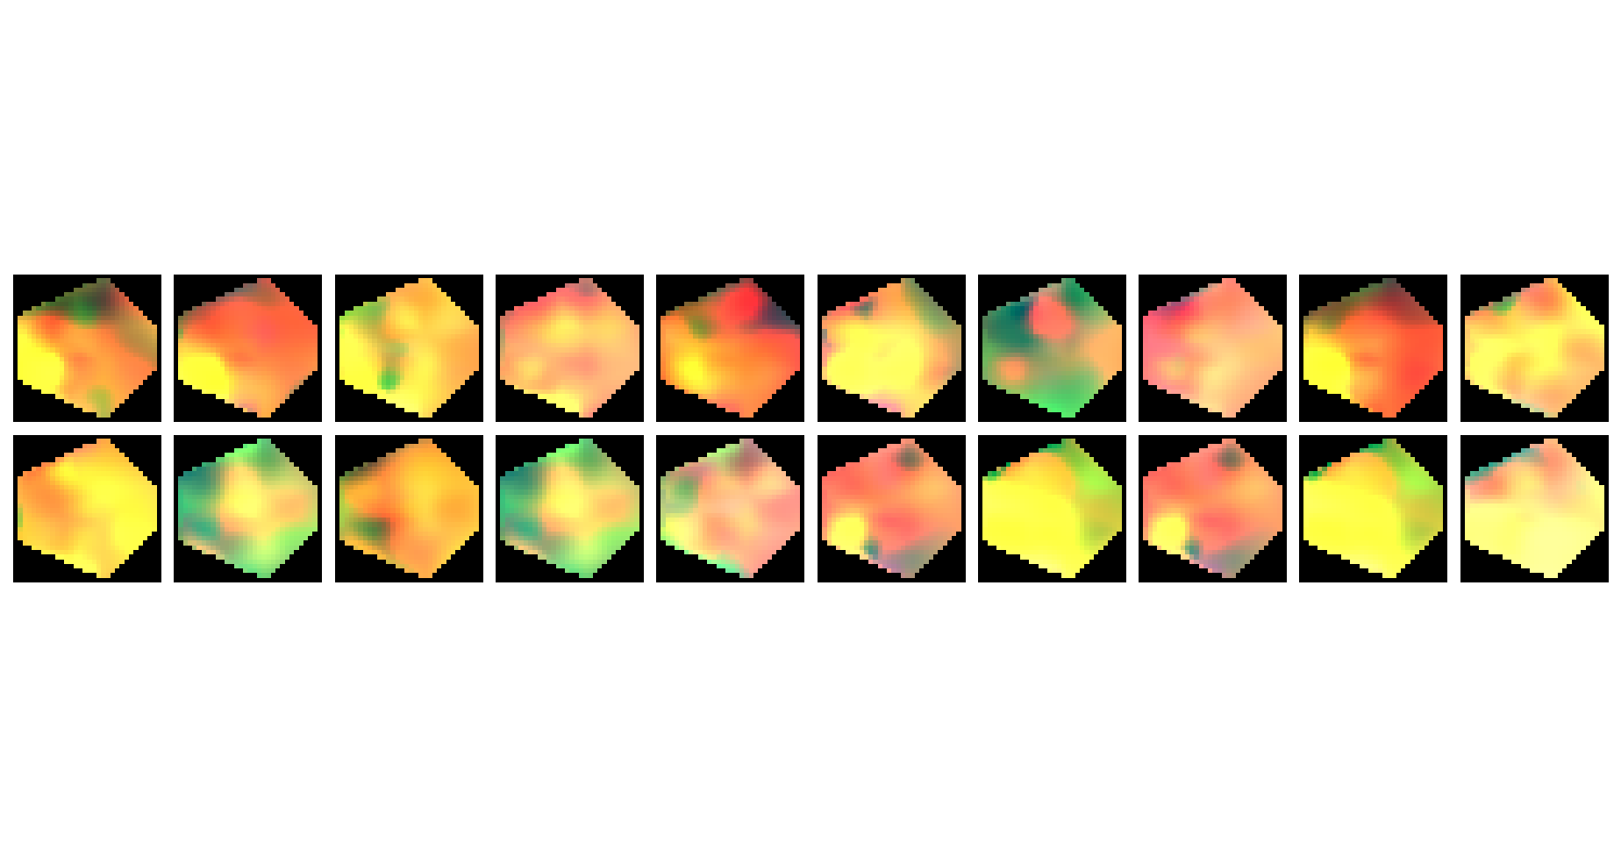

Slide 58
ERSP:Event-Related Spectral Power
ERSP
Gamma
Beta
Frequency
Alpha
Theta
Delta
Time
Notes:
Note:
These visuals can represent a multi-directional array (3D) input, tensor, etc.
Author: Elvis Saravia (ellfae@gmail.com)

Slide 59
SM
FC
AM
L
L
L
L
L
L
L
L
L
L
Conv
C
C
C
C
C
C
C
C
C
C

Slide 60
SM
FC
Attention
L
L
L
L
L
L
L
L
L
L
C
C
C
C
C
C
C
C
C
C

Slide 61
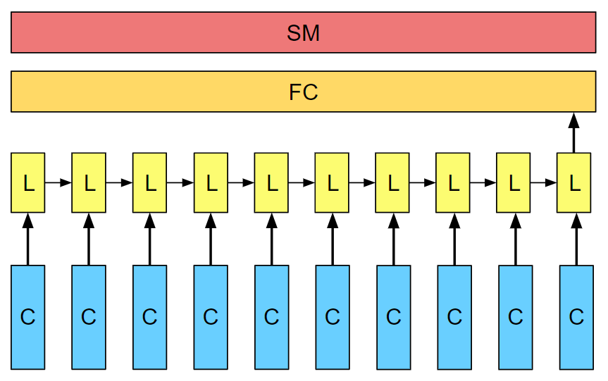
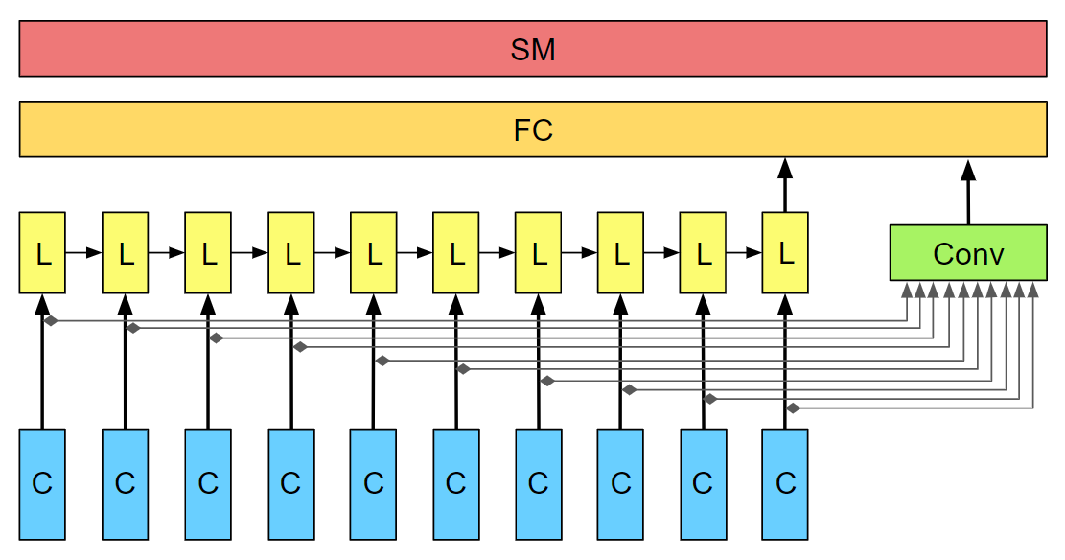
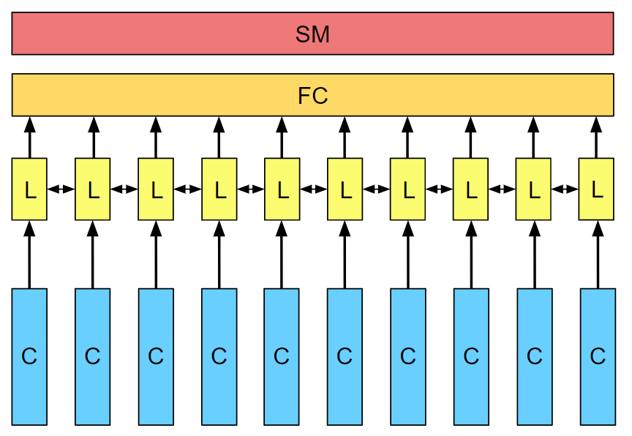
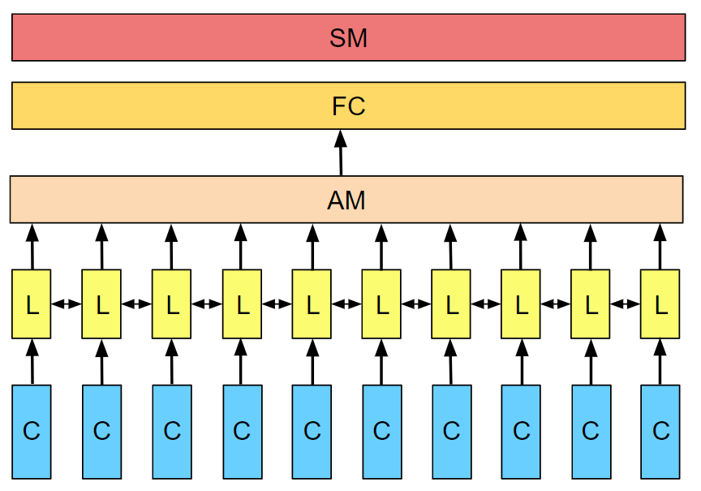
A) CNN-LSTM
B) CNN-LSTM/1D-Conv
C) CNN-BiLSTM
D) CNN-ANN-BiLSTM (ARCNN)

Slide 62
A) LSTM
B) LSTM / 1D-Conv
C) BiLSTM
D) Att-BiLSTM

Slide 63
SM
FC
L
L
L
L
L
L
L
L
L
L
C
C
C
C
C
C
C
C
C
C

Slide 64
SM
FC
L
L
L
L
L
L
L
L
L
L
Conv
C
C
C
C
C
C
C
C
C
C

Slide 65
SM
FC
AM
L
L
L
L
L
L
L
L
L
L
L
L
L
L
L
L
L
L
L
L
Conv
C
C
C
C
C
C
C
C
C
C

Slide 66
SM
FC
AM
L
L
L
L
L
L
L
L
L
L
L
L
L
L
L
L
L
L
L
L
Conv
C
C
C
C
C
C
C
C
C
C

Slide 67
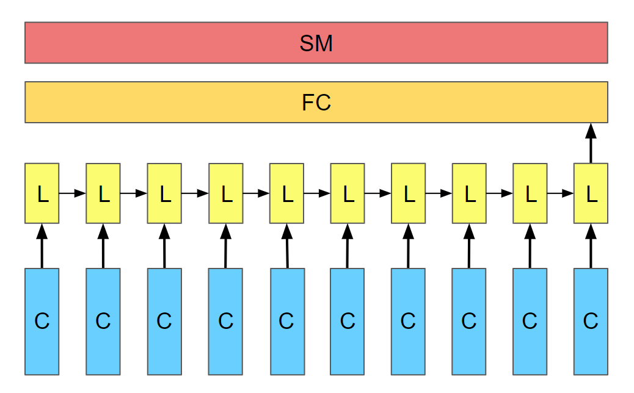
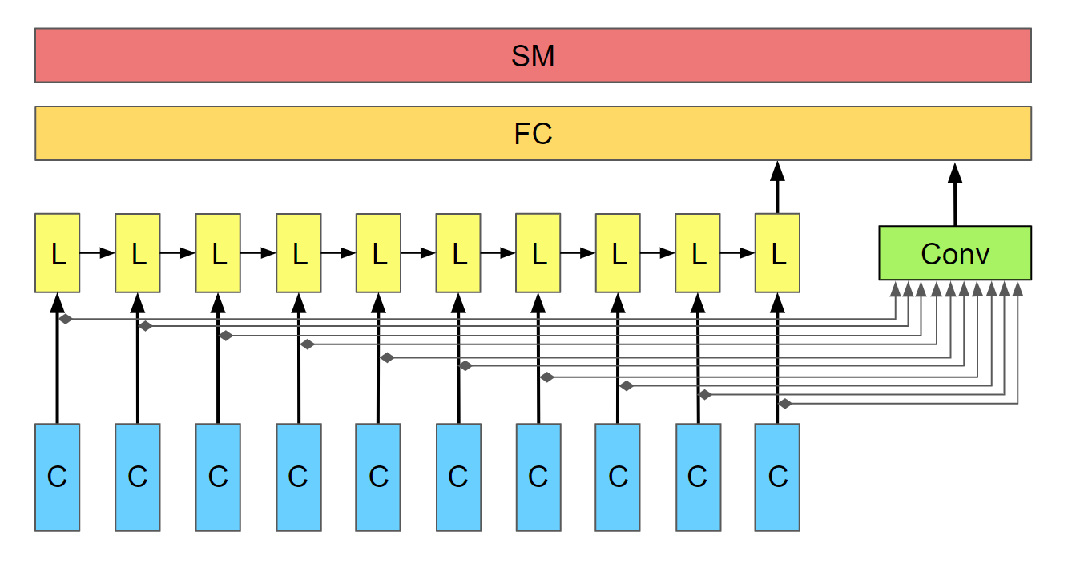
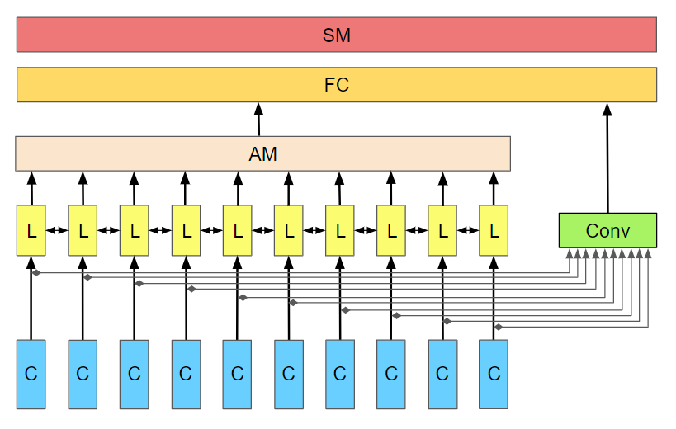
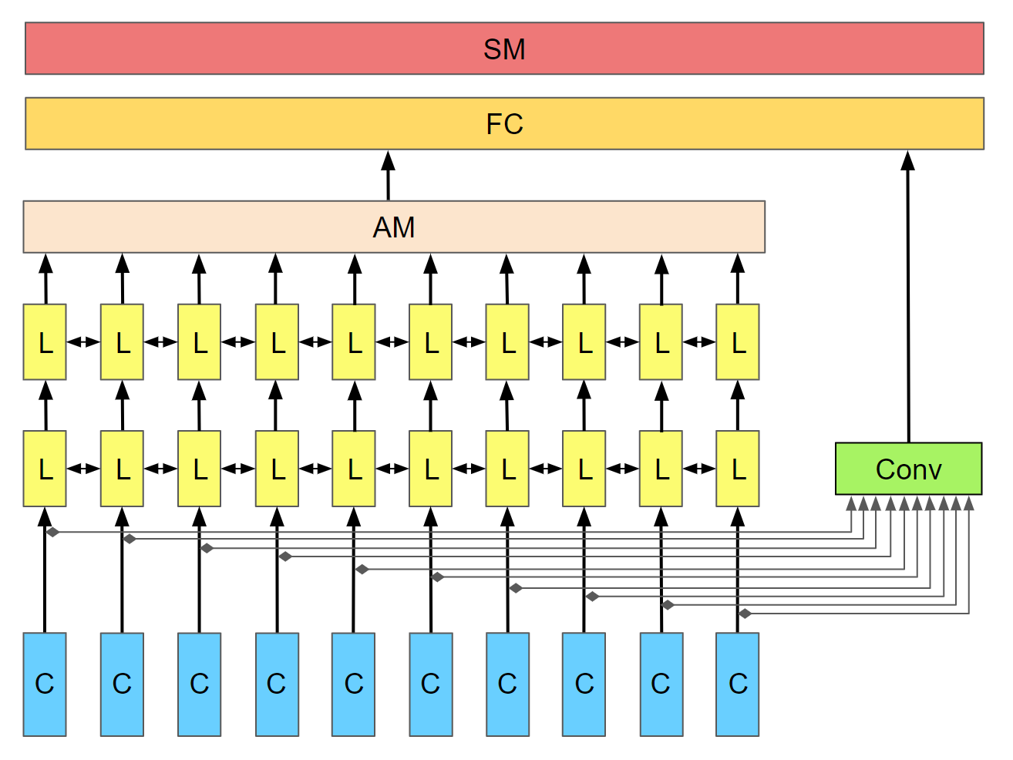

Slide 68
SM
FC
L
L
L
L
L
L
L
L
L
L
Conv
C
C
C
C
C
C
C
C
C
C

Slide 69
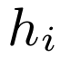
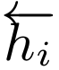
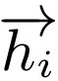
Attention Layer
BiLSTM
Layer
BiLSTM
Layer
CNN
Layer
C
C
C
C
C
C
C
C
C
C

Slide 70
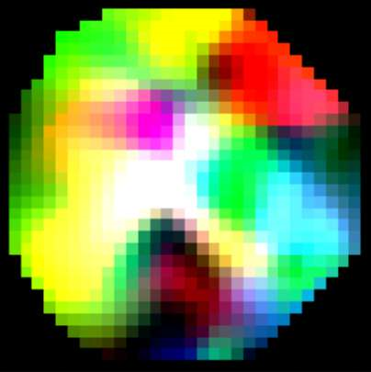
Attention Layer
BiLSTM
Layer
BiLSTM
Layer
CNN
Layer
C
C
C
C
C
C
C
C
C
C
EEG Image
Sequence

Slide 71
Attention layer
LSTM layer
CNN
layer
C
C
C
C
C
C
C
C
C
C

Slide 72
Output
Attention layer
LSTM layer
CNN
layer
C
C
C
C
C
C
C
C
C
C

Slide 73
SM
FC
L
L
L
L
L
L
L
L
L
L
C
C
C
C
C
C
C
C
C
C

Slide 74
SM
FC
AM
L
L
L
L
L
L
L
Conv
C
C
C
C
C
C
C

Slide 75
Striding in CONV
S=1
S=2
Notes:
Created by @srvmshr
Sourav @ yahoo.com

Slide 76
Notes:
Created by @srvmshr
Sourav @ yahoo.com

Slide 78
Inception Module
MaxPool Same s=1
5x5 Same
3x3 Same
NxNx192
1x1 Same
NxNx192
NxNx128
NxNx32
NxNx64
Notes:
Created by @srvmshr
Sourav @ yahoo.com

Slide 79
t-1
t
Retraining w/o expansion
Notes:
Note:
1 hidden layer neural network
Author: Elvis Saravia (ellfae@gmail.com)

Slide 80
No-Retraining w/ expansion
Partial Retraining w/ expansion
Notes:
Note:
1 hidden layer neural network
Author: Elvis Saravia (ellfae@gmail.com)

Slide 81
t-1
t
t-1
t
No-Retraining w/ expansion
Partial Retraining w/ expansion
Notes:
Note:
1 hidden layer neural network
Author: Elvis Saravia (ellfae@gmail.com)

Slide 82
t-1
t
t-1
t
t-1
t
Retraining expansion
No-Retraining expansion
Partial Retraining expansion
Notes:
Note:
1 hidden layer neural network
Author: Elvis Saravia (ellfae@gmail.com)

Slide 83
Size
Family?
X
Y
#bed
Walk?
PRICE ŷ
Basic Neuron Model
ZIP
School
How does NN work (Insprired from Coursera)
Wealth
Ŷ = 0
X
Logistic Regression
Ŷ = 1
Notes:
By @srvmshr
sourav@yahoo.com

Slide 84
Linear regression
ReLU(x)
$
$
Size
Size
Notes:
By @srvmshr
sourav@yahoo.com

Slide 85
Training
CONV
3
CONV
1
CONV
2
CONV
5
CONV
6
CONV
7
I
I1
CONV
4
128*128*1
128*128*1
Encoder
Decoder
Decoder
V1
V
ENcoder
128*128*1
128*128*1
Notes:
By @srvmshr
sourav@yahoo.com

Slide 86
Large NN
Med NN
η
Small NN
SVM,LR etc
Amount of Data
Why does Deep learning work?
Notes:
By @srvmshr
sourav@yahoo.com

Slide 87
Hidden
Input
Output
a^{[1]}₁
a^{[1]}₂
One hidden layer neural network
X
a^{[2]}
Ŷ
a^{[1]}₃
a^{[1]}₄
X = A^{[0]}
A^{[1]}
A^{[2]}
Notes:
By @srvmshr
sourav@yahoo.com

Slide 88
a^{[1]}₁
x_{[1]}
a^{[2]}
a^{[1]}₂
x_{[2]}
x_{[1]}
x_{[2]}
x_{[3]}
Neural network templates
Notes:
By @srvmshr
sourav@yahoo.com

Slide 89
Train
Valid
Test
Underfitting
Good fit
Overfitting
x2
x2
x2
x1
x1
x1
Train-Dev-Test vs. Model fitting
Notes:
By @srvmshr
sourav@yahoo.com

Slide 90
x_{[1]}
x_{[2]}
a_{[L]}
DropOut
x_{[3]}
x2
r=1
x2
Normalization
x1
x1
Notes:
By @srvmshr
sourav@yahoo.com

Slide 91
J
w2
Early stopping
Err
w1
w1
w2
Before Normalization
Dev
Train
it.
J
w2
w1
w1
After Normalization
w2
Notes:
By @srvmshr
sourav@yahoo.com

Slide 92
x₁
x₂
w[L]
w[1]
w[2]
w[L-2]
w[L-1]
Deep neural networks
FN
TN
TP
FP
Understanding
Precision & Recall
Notes:
By @srvmshr
sourav@yahoo.com

Slide 93
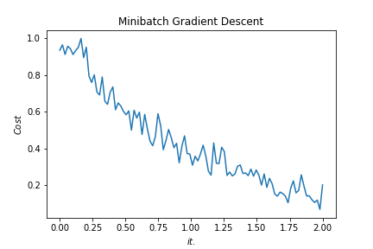
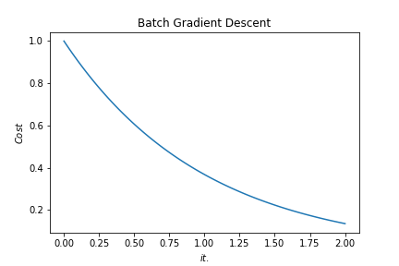
Batch vs. Mini-batch Gradient Descent
w2
w2
BGD
SGD
Batch Gradient Descent vs. SGD
SGD
w1
w1
Notes:
By @srvmshr
sourav@yahoo.com

Slide 94
x_{[1]}
p_{[1]}
x_{[2]}
p_{[2]}
x_{[3]}
Softmax Prediction with 2 outputs
Notes:
By @srvmshr
sourav@yahoo.com

Slide 95
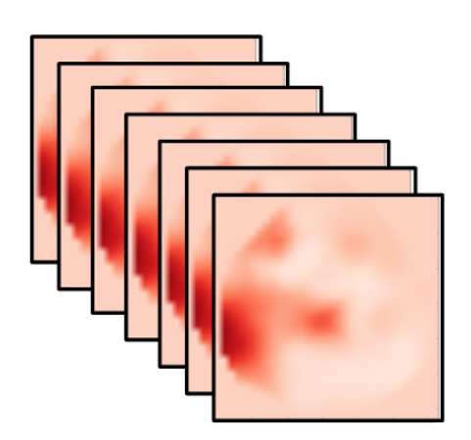
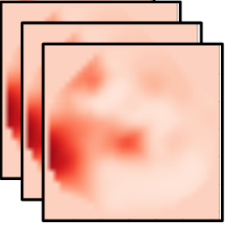
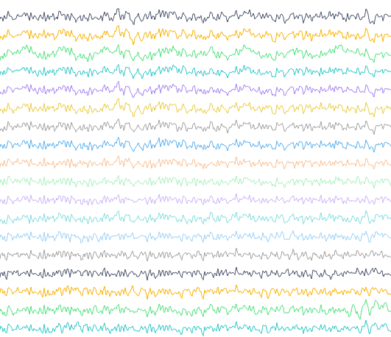
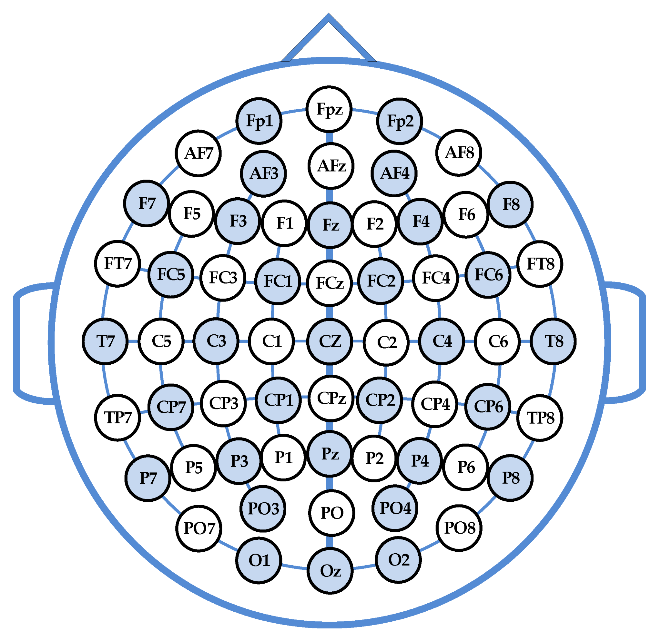
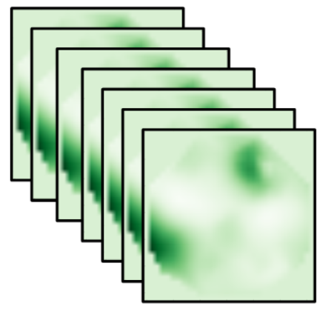
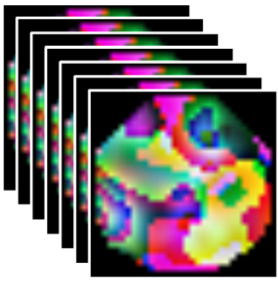
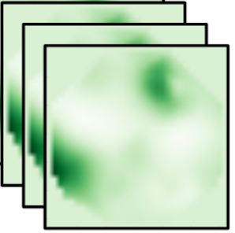
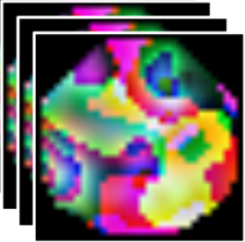
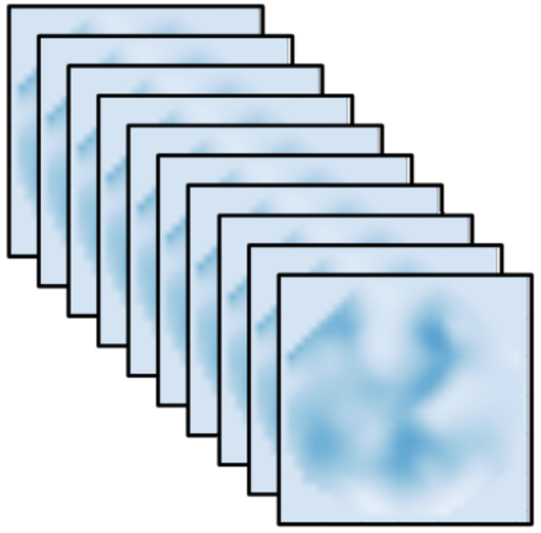
Time slice
Alpha
Delta
CNN
CNN
ICA
Conv
RNN+ANN
CNN
Conv
CNN
Alpha
Conv
CNN
Conv
CNN
Conv
CNN
Conv
CNN
EEG
Cap
Band-Pass
Filter
Conv
Beta
CNN
CNN
Spectral-Temporal Feature Learning
Pain Intensity Assessment
Spatial Feature Learning
Spectral Topography Maps
EEG Images
EEG Time Series
Notes:
Note:
These visuals can represent a multi-directional array (3D)
Author: Elvis Saravia (ellfae@gmail.com)

Slide 96
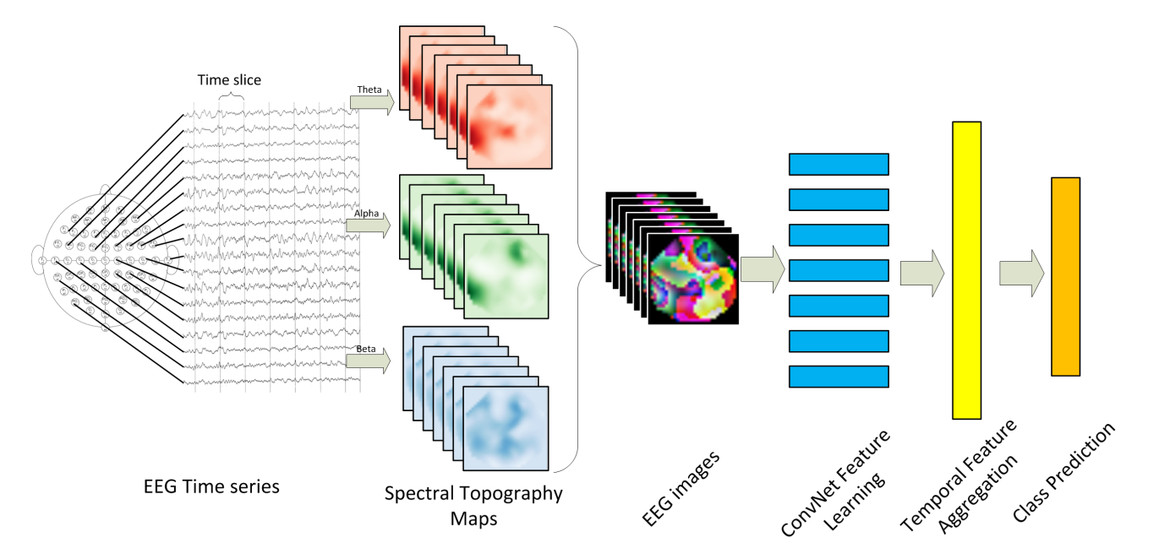
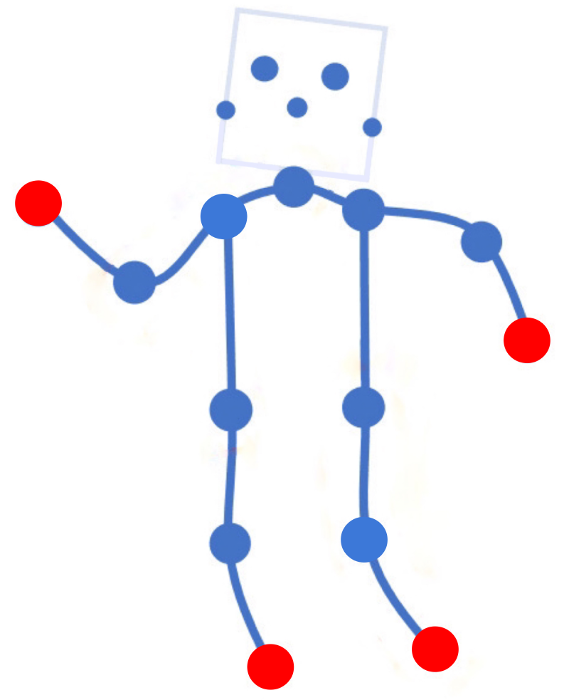
Time slice
Delta
No pain
Alpha
CNN
ICA
CNN
Conv
RNN+ANN
CNN
Conv
Alpha
CNN
Conv
CNN
Conv
CNN
Conv
CNN
Conv
Beta
CNN
Conv
CNN
CNN
Pain Intensity Assessment
Pain
Localization
Spatial Feature Learning
Temporal Feature Aggregation
Spectral Topography Maps
EEG Images
EEG Time Series
Notes:
Note:
These visuals can represent a multi-directional array (3D)
Author: Elvis Saravia (ellfae@gmail.com)

Slide 98
Conv
Conv
Conv
Conv
Conv
Conv
Conv
Conv
Conv
Conv

Slide 99



Slide 101
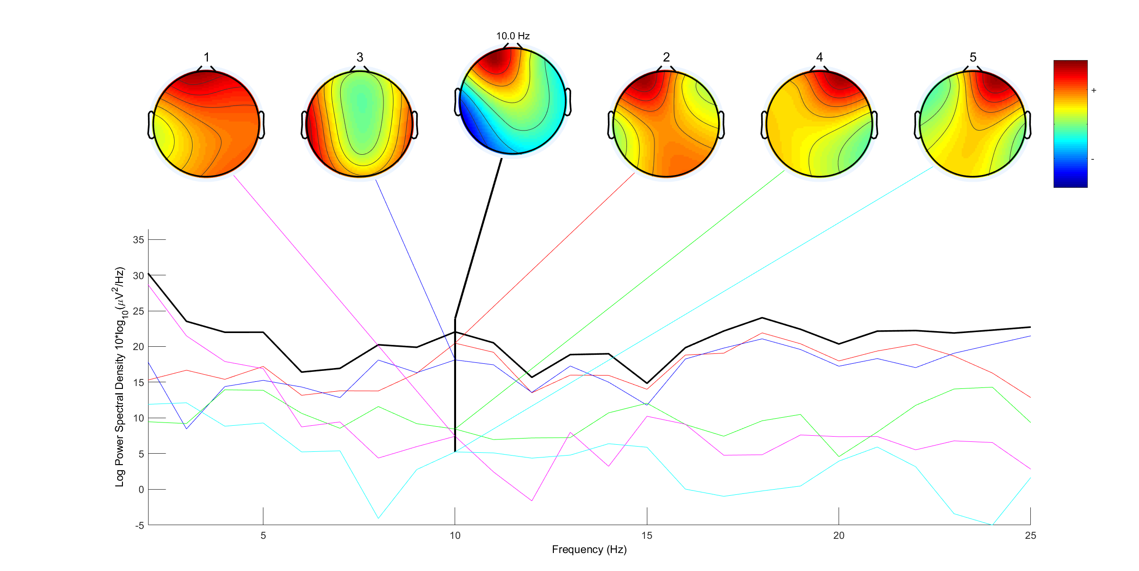

Slide 102
Level-1
Level-2
Level-3
Level-4
5s
Sliding Window
Event-Marker
…
No Pain
Low Pain
High Pain
Intolerable Pain
Time
Immerse
hand
Withdraw
hand
Notes:
Note:
Can represent a multidimensional array (2D)
Author: Elvis Saravia (ellfae@gmail.com)

Slide 103
Withdraw
hand
Immerse
hand
Level 1
Level 2
Level 3
Level 4
No Pain
Low Pain
Moderate Pain
High Pain
Time
Signal Segmentation
Notes:
Note:
Can represent a multidimensional array (2D)
Author: Elvis Saravia (ellfae@gmail.com)

Slide 104
Level-1
Level-2
Level-3
Level-4
5s
Sliding Window
Event-Marker
…
Time
No Pain
Low Pain
High Pain
Intolerable Pain
Immerse
hand
Withdraw
hand
Notes:
Note:
Can represent a multidimensional array (2D)
Author: Elvis Saravia (ellfae@gmail.com)

Slide 105
Level 1
Level 2
Level 3
Level 4
No Pain
Low Pain
Medium Pain
High Pain
Time
Immerse
hand
Withdraw
hand
Notes:
Note:
Can represent a multidimensional array (2D)
Author: Elvis Saravia (ellfae@gmail.com)

Slide 106
Input
Conv3-32
x4
Maxpool
(2x2)
Conv3-64
x2
32x32x3
Maxpool
(2x2)
Conv3-
128
Maxpool
(2x2)
Output
FC-512
Feature
Vector
ConvNet Configuration
Notes:
Note:
These visuals can represent a multi-directional array (3D)
Author: Elvis Saravia (ellfae@gmail.com)

Slide 107
Layer1
Layer2
Layer3
Layer1
Layer2
Layer3
Layer4
Input
Output
Conv3-32
Conv3-32
Max-Pool
Conv3-64
Max-Pool
Conv3-128
Conv3-32
Conv3-32
Conv3-32
Conv3-32
Conv3-32
Conv3-32
Conv3-64
Max-Pool
Input
Conv
Max-Pool
Conv
Max-Pool
FC
FC
Softmax
ConvNet Configuration
Stack1
Stack2
Stack3
Stack4
Conv3-32
Output
Conv3-32
Conv3-32
Conv3-32
Max-Pool
Conv3-64
Max-Pool
Conv3-128
Max-Pool
Conv3-64
FC-512
Notes:
By @avsthiago

Slide 108
Layer1
Layer2
Layer3
Layer1
Layer2
Layer3
Layer4
Input
Output
Conv3-32
Conv3-32
Max-Pool
Conv3-64
Max-Pool
Conv3-128
Conv3-32
Conv3-32
Conv3-32
Conv3-32
Conv3-32
Conv3-32
Conv3-64
Max-Pool
Input
Conv
Max-Pool
Conv
Max-Pool
FC
FC
Softmax
ConvNet Configuration
Conv1
Number Pafs
Conv1-512
Conv3-128
Conv1-128
Conv3-128
dia=2
Conv3-128
Conv3-128
Conv1-128
Conv1
Number Keypoints
Conv1-512
Notes:
By @avsthiago

Slide 109
Output
Inception 2
Inception 2
Inception 2
Inception 1
FC
FC
1x7 conv
1x7 conv
1x11 conv
1x11 conv
Input
Previous input
x
F(x)
Stacked layers
x
identity
+
y=F(x)+x

Slide 110
Layer1
Layer2
Layer3
Input
Output
Conv3-32
Conv3-32
Max-Pool
Conv3-64
Max-Pool
Conv3-128
Conv3-32
Conv3-32
Conv3-32
Conv3-32
Conv3-32
Conv3-32
Conv3-64
Max-Pool
ConvNet Configuration
Layer1
Layer2
Layer3
Conv3-32
Output
Conv3-32
Max-Pool
Conv3-64
Max-Pool
Conv3-128
Conv3-32
Conv3-32
Conv3-32
Conv3-32
Conv3-32
Conv3-32
Conv3-64
Max-Pool
ConvNet Configuration
Notes:
By @avsthiago

Slide 111
Stack1
Stack2
Stack3
Stack4
Conv3-32
Conv3-32
Max-Pool
Output
Conv3-64
Max-Pool
Conv3-128
Max-Pool
Conv3-64
FC-512
Conv3-32
Conv3-32

Slide 112
Time
Unbearable
Pain
Level 5
Level 4
High
Pain
MediumPain
Level 3
Level 2
LowPain
Level 1
No Pain
(a)
(b)

Slide 113
Level 1
Level 2
Level 3
Level 4
Level 5
Time
No Pain
LowPain
MediumPain
High
Pain
Unbearable
Pain
(a)
(b)

Slide 114
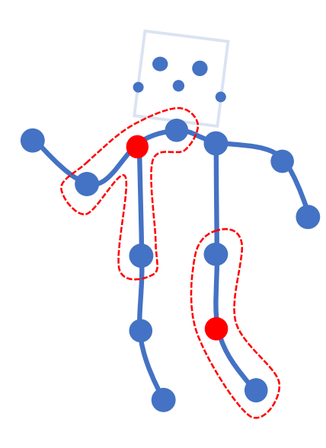
Notes:
Note:
Can represent a multidimensional array (2D)
Author: Elvis Saravia (ellfae@gmail.com)

Slide 115
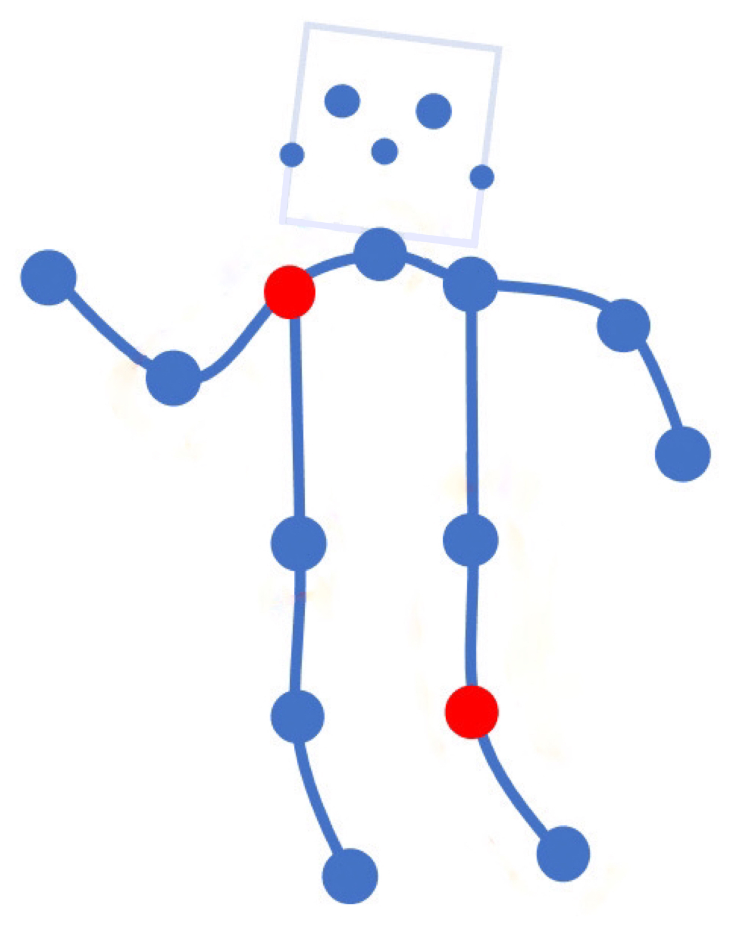
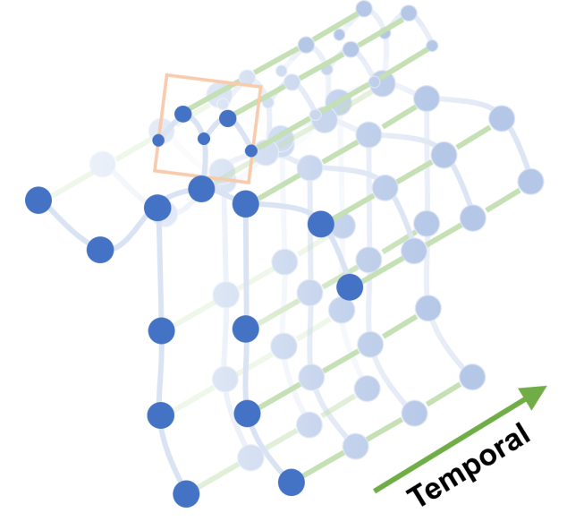
Notes:
Note:
Can represent a multidimensional array (2D)
Author: Elvis Saravia (ellfae@gmail.com)

Slide 116
Miscellaneous

Slide 117
16
16+32
16
16
1
3
Convolution 3x3
Convolution 1x1
Dropout 0.1
16
Max Pooling 2x2
Skip connection
Dropout 0.2
Up Sampling 2x2
Block copied
Dropout 0.3
32
32
32+64
32
64
64
64+128
64
128
128
128+256
128
256
256
Notes:
By @avsthiago

Slide 118
Layer1
Layer2
Layer3
Layer1
Layer2
Layer3
Layer4
Input
Output
Conv3-32
Conv3-32
Conv3-32
Conv3-32
Max-Pool
Conv3-64
Max-Pool
Conv3-128
Max-Pool
Conv3-64
FC-512
Input
Conv
Max-Pool
Conv
Max-Pool
FC
FC
Softmax
Layer1
Layer2
Layer3
Layer4
Conv3-32
Output
Feature
Vector
Conv3-32
Conv3-32
Conv3-32
Max-Pool
Conv3-64
Max-Pool
Conv3-128
Max-Pool
Conv3-64
FC-512
Notes:
By @avsthiago

Slide 119
Filter concatenation
3x3 convolutions
5x5 convolutions
1x1 convolutions
1x1 convolutions
1x1 convolutions
1x1 convolutions
3x3 max pooling
Previous layer
Notes:
By @avsthiago

Slide 120
Filter concatenation
3x3 convolutions
5x5 convolutions
1x1 convolutions
1x1 convolutions
1x1 convolutions
1x1 convolutions
3x3 max pooling
Previous layer
Notes:
By @avsthiago

Slide 121
Previous layer
1x3 conv,
1 padding
1x3 conv,
1 padding
1x7 conv,
3 padding
1x3 conv,
1 padding
1x5 conv,
2 padding
1x3 conv,
1 padding
Filter concatenation

Slide 122
Avg-Pool
Auxiliary Classifier
Conv
FC
FC
Softmax
Inception
Input
Inception
Conv
Max-Pool
Conv
Max-Pool
Conv
Max-Pool
Inception
Inception
Max-Pool
Inception
Inception
Inception
Inception
Inception
Max-Pool
Avg-Pool
Conv
FC
Softmax
Avg-Pool
Auxiliary Classifier
Conv
FC
FC
Softmax
Notes:
By @avsthiago

Slide 123
Filter concatenation
Filter concatenation
3x3 conv.
1x3 conv.
3x1 conv.
1x1 conv.
3x3 conv.
3x3 conv.
1x1 conv.
1x3 conv.
3x1 conv.
3x3 conv.
1x1 conv.
1x1 conv.
Pool
1x1 conv.
1x1 conv.
Pool
1x1 conv.
1x1 conv.
Previous layer
Previous layer
(a)
(b)
Notes:
By @avsthiago

Slide 124
Previous input
Previous input
x
x
F(x)
F(x)
Stacked layers
Stacked layers
x
identity
+
y=F(x)
y=F(x)+x
R1
R1
R2
R1
R1
R2
R3
R1
R2
R3
Notes:
By @avsthiago

Slide 125
Dense Block 1
Dense Block 2
Dense Block 3
Softmax
FC
Avg-Pool
Avg-Pool
Conv
Conv
Input
Avg-Pool
Conv
Transition layers
Notes:
By @avsthiago

Slide 126
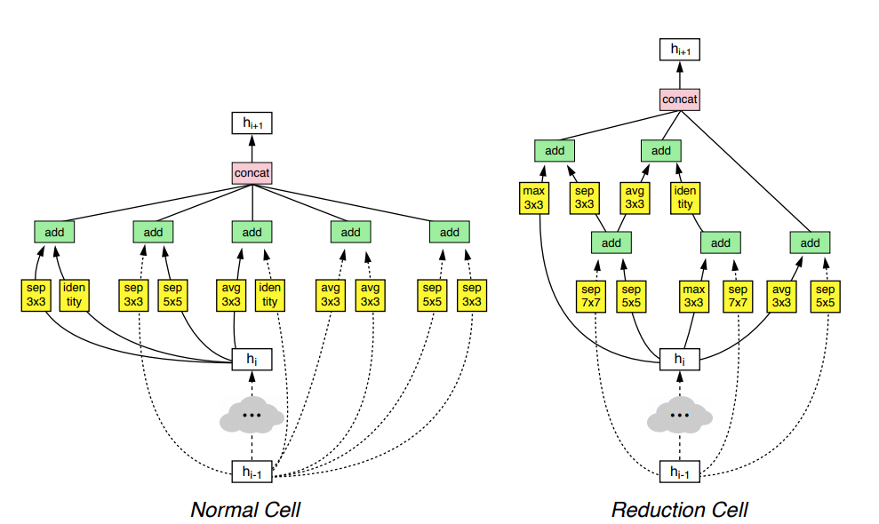
h_{i+1}
Filter concatenation
h_{i+1}
add
add
Filter concatenation
3x3 max
3x3 conv
3x3 avg
identity
add
add
add
add
add
add
add
add
3x3 conv
identity
3x3 conv
5x5 conv
3x3 avg
identity
3x3 avg
3x3 avg
3x3 conv
5x5 conv
7x7 conv
5x5 conv
3x3 max
7x7 conv
3x3 avg
5x5 conv
h_{i}
h_{i}
...
...
h_{i-1}
h_{i-1}
(a)
(b)
Notes:
By @avsthiago

Slide 127
Notes:
By @avsthiago

Slide 128
Notes:
By @avsthiago
Dark-theme version of the previous (by Elvis Saravia)

Slide 129
Max(1,1,5,6) = 6
Y
1
1
2
4
5
6
7
8
6
8
3
2
1
0
Pooling performed with a 2x2 kernel and a stride of 2
3
4
1
2
3
4
X
Image Representation
Notes:
By @avsthiago

Slide 130
APP
疼痛等级
治疗力度
EEG
疼痛识别
疼痛治疗仪
疼痛位置
治疗方案
使用者的治疗时长、治疗方案、治疗反馈记录
Notes:
Note:
Can represent a multidimensional array (2D)
Author: Elvis Saravia (ellfae@gmail.com)

Slide 131
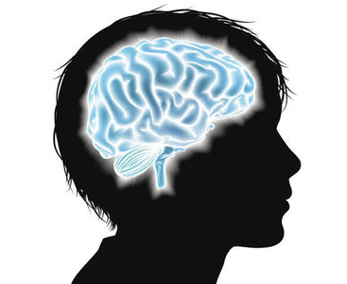
Closed-loop Control
Pain Recognition
APP
疼痛强度
Deep
Learning
Page Design
EEG
Pain Localization
Data
Mining
Reinforce
Learning
治疗反馈
脑电检测
治疗方案
治疗力度
Pain Treatment Apparatus
Pain Management
Appearance
Design
Circuit
Design

Slide 132
应用场景
普通患者：能够自己感觉到疼痛并报告出来。
对于该类患者可以脱离脑电波头盔而单独存在，用户根据自身感觉，使用该疼痛治疗仪和app，将tens片放置疼痛源部位，可自行选择不同的治疗模式或使用我们的智能推荐模式进行治疗，有效地减缓疼痛。在该应用场景下，我们的产品依赖于人体的主观感觉和反馈，在强化学习和数据挖掘的基础上进行智能治疗。
优点：使用范围广，成本低，无创伤，智能治疗
特殊患者：无法感觉疼痛或无法报告出来，如老年痴呆症患者，婴幼儿，手术前/后，或处于昏迷状态的患者。
对于该类患者，我们引入了脑机接口技术，通过检测患者的脑电活动，识别出疼痛强度和疼痛位置，将信息传至app端，便可根据该结果进行准确治疗。治疗过程中，患者脑电波能够做出一定的反馈，根据该反馈进行强化学习不断调整治疗参数，以达到有效且精确的治疗。
优点：更为客观的基于脑电波的疼痛识别，较高的临床价值，无创伤，智能治疗
缺点：脑电头盔成本高，使用范围较为局限
脑电监测：仅需监控，无需治疗，可使用我们的疼痛识别算法系统（软件），可应用于手术中患者的疼痛监测等。

Slide 133
APP
页面设计
数据挖掘
强化学习
主观疼痛感受
普通用户
治疗反馈
治疗方案
治疗力度
疼痛治疗
疼痛治疗仪
外观设计
电路设计

Slide 134

疼痛识别
APP
疼痛强度
深度学习
页面设计
EEG
疼痛定位
数据挖掘
强化学习
特殊患者
脑电监测
脑电信号
采集/反馈
治疗方案
治疗力度
疼痛治疗仪
疼痛治疗
外观设计
电路设计

Slide 135
疼痛识别
APP
疼痛强度
深度学习
页面设计
EEG
疼痛定位
数据挖掘
强化学习
脑电信号
采集/反馈
主动反馈
治疗方案
治疗力度
疼痛治疗仪
疼痛治疗
外观设计
电路设计

Slide 136
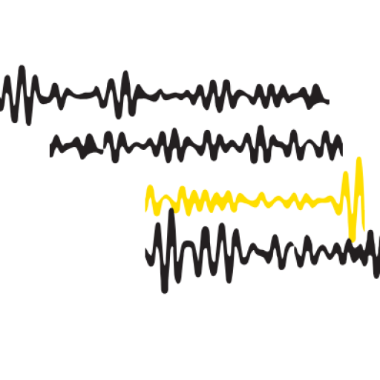
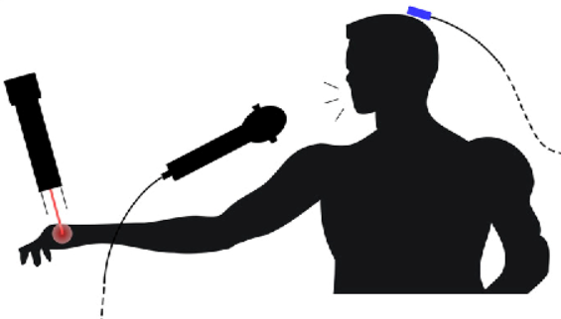

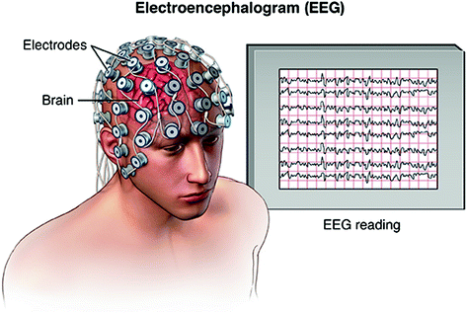
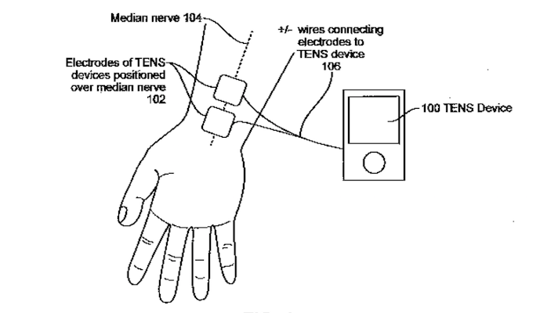


信号处理
特征提取
疼痛分类
服务器
机器挖掘
强化学习
治疗参数自动调整
EEG
疼痛检测系统
某疼痛源
（人体）
疼痛检测及缓解脑机交互系统
智能控制系统
治疗参数主动调整
可视化
治疗反馈
Tens片
识别结果
治疗记录
个人信息
治疗系统
治疗参数
疼痛缓解
用户端

Slide 137
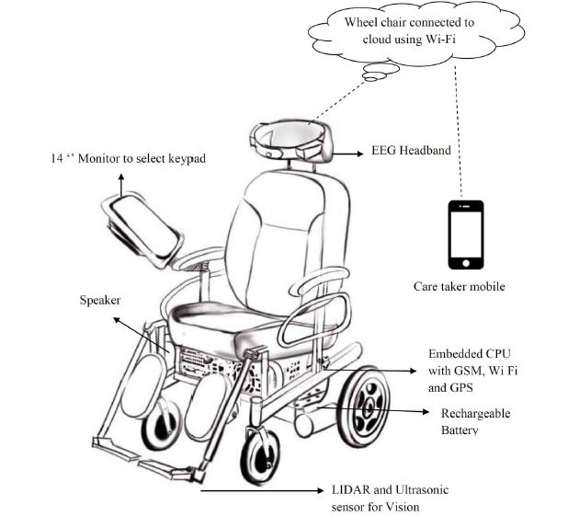
Wheelchair connected to cloud using Wi-Fi
App
控制界面
EEG Headband
Tens 片
服务器
疼痛检测
智能控制
疼痛缓解系统
Embedded CPU with GSM, WiFi, and GPS
Rechargeable Battery
LIDAR and Ultrasonic sensor for vision
Tens 片

Slide 138
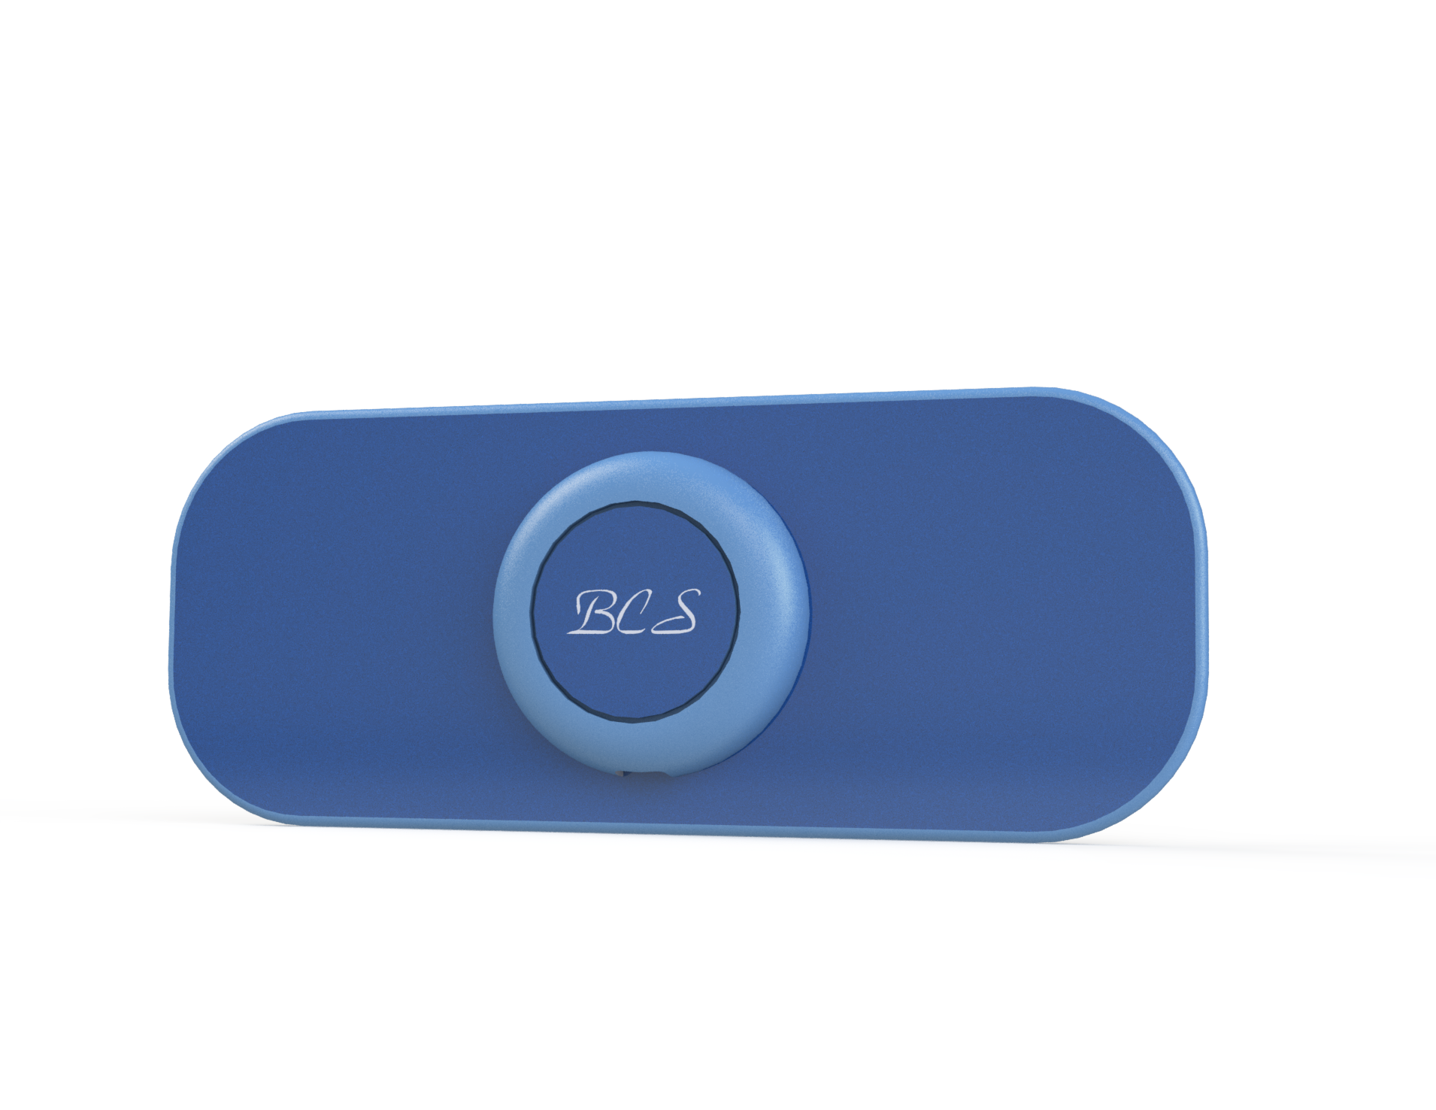
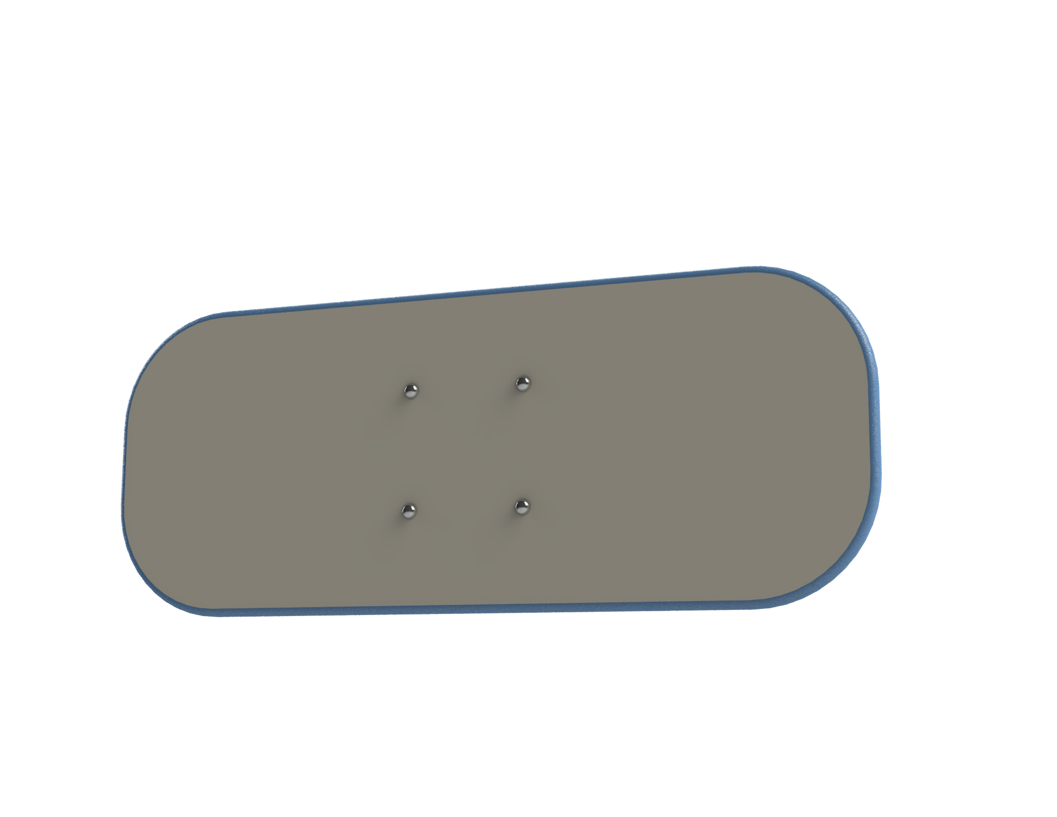
不同场景—— 痛经治疗仪

Slide 140
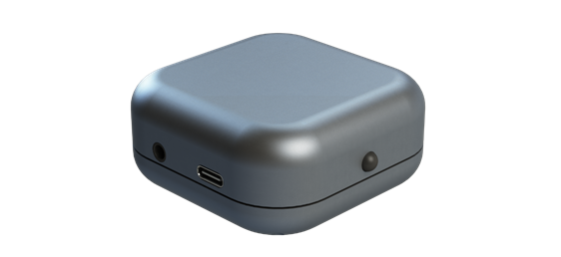

Slide 141
疼痛识别
APP
疼痛强度
深度学习
页面
设计
EEG
疼痛定位
数据挖掘
强化学习
特殊患者
脑电信号
采集/反馈
主观疼痛感受
治疗方案
治疗力度
治疗反馈
疼痛治疗仪
疼痛治疗
外观设计
电路设计

Slide 142
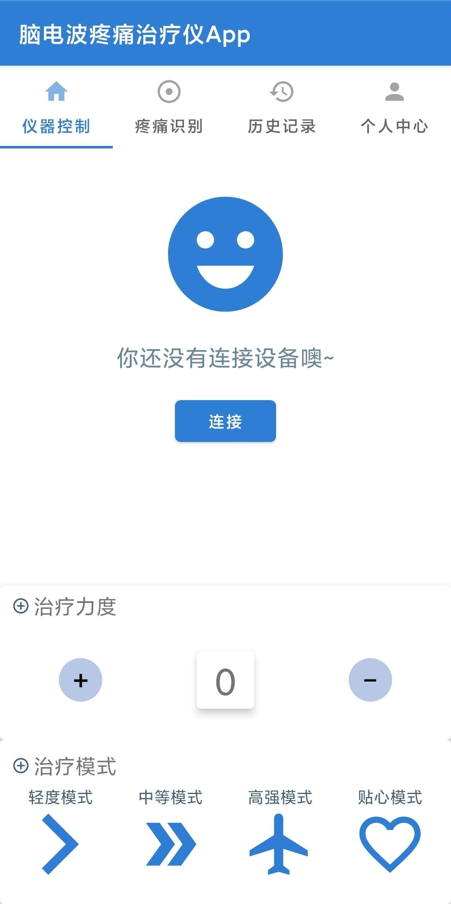
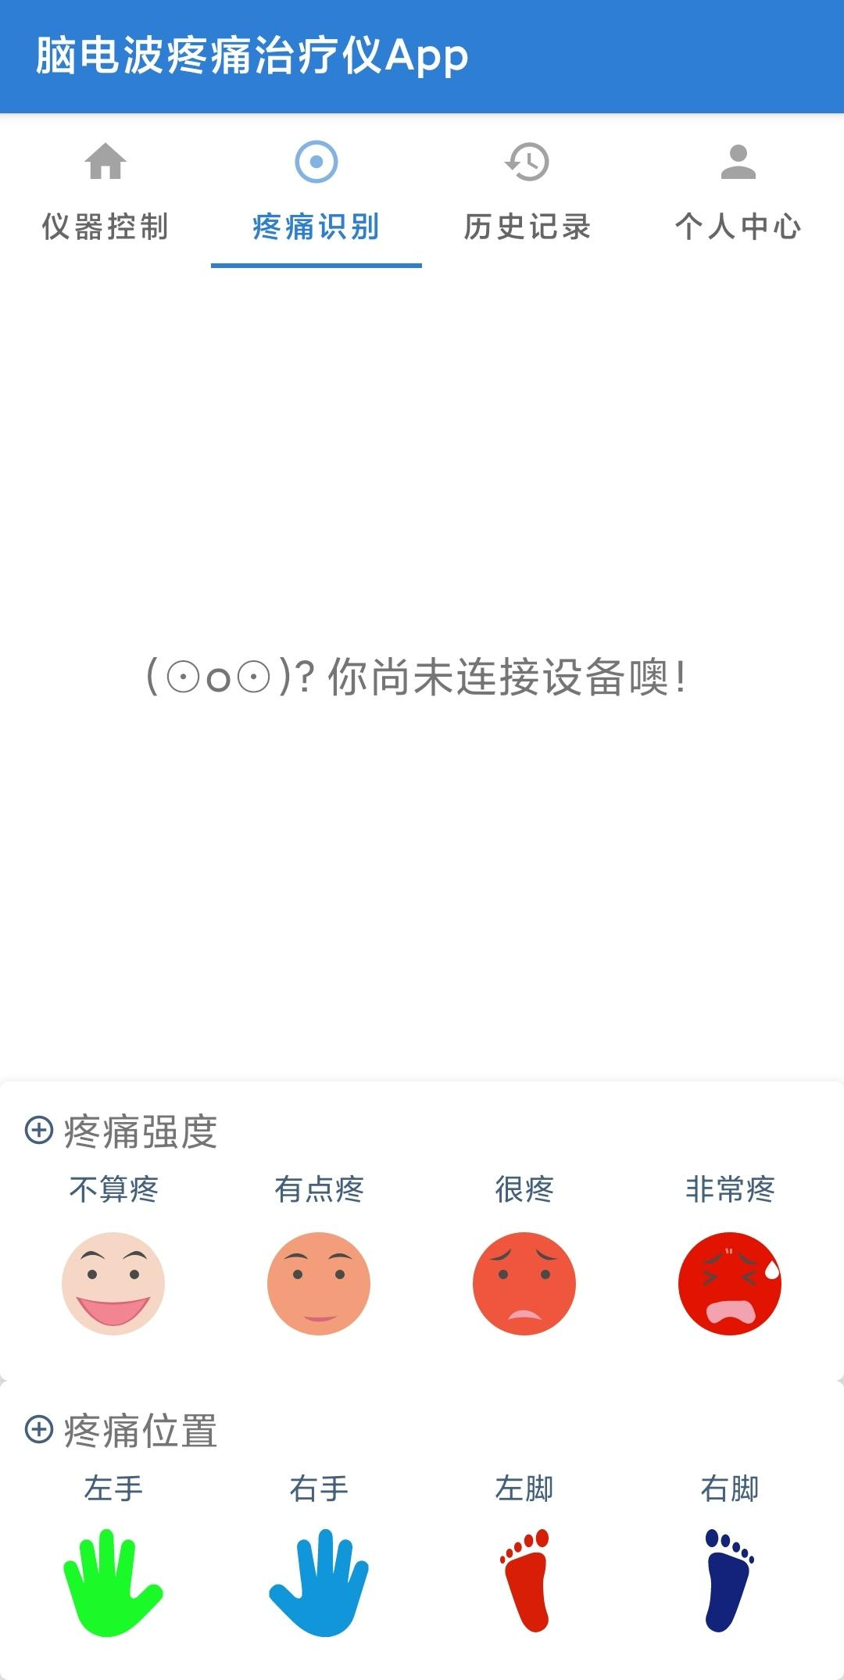
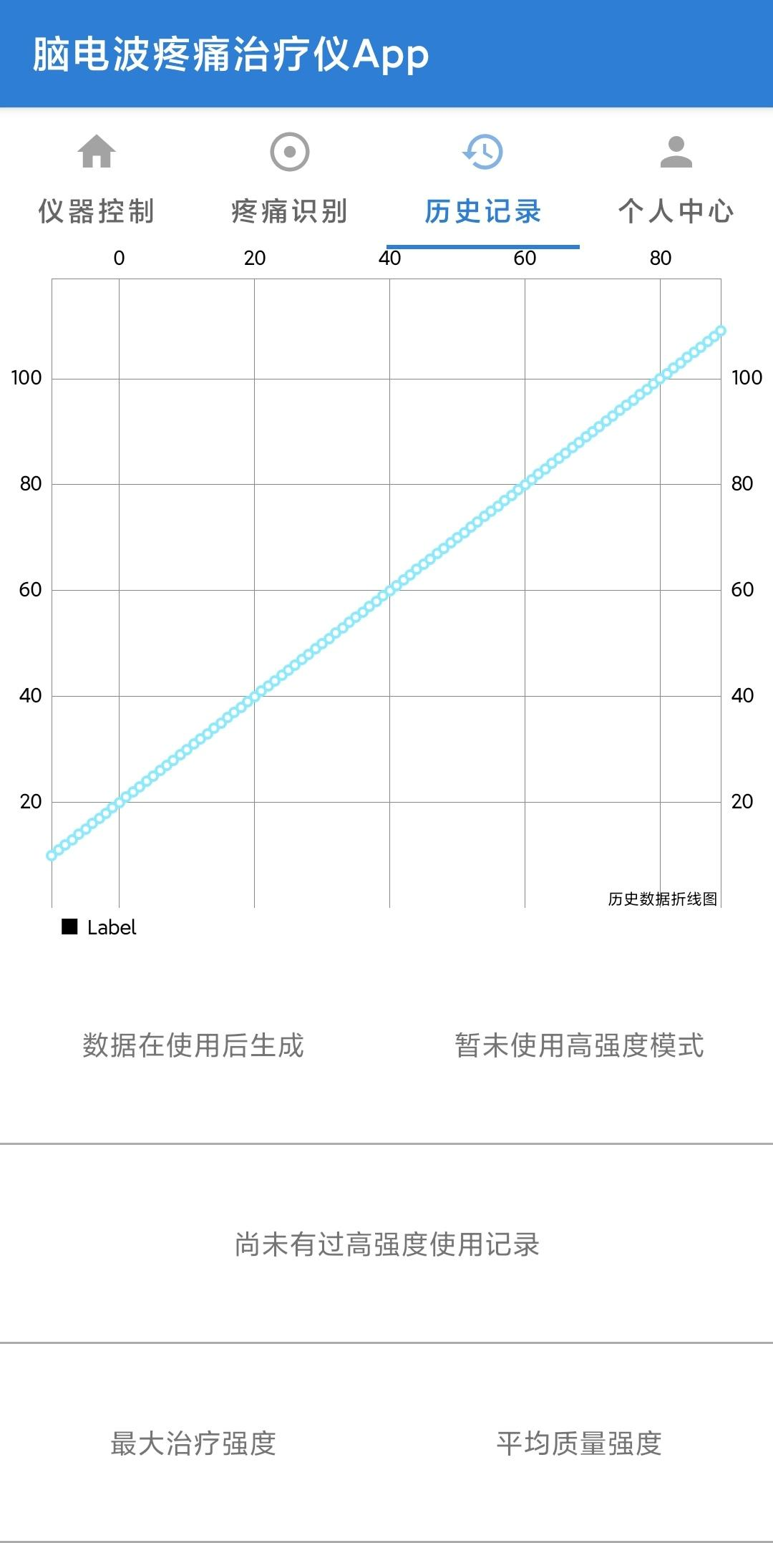


Slide 143


Slide 144
Video Stream
Skeleton Extraction
Fall
Detection
Email
Alert
Abnormal
Normal

Slide 145


Conv1
Number Pafs
Conv1-512
Conv3-128
Conv1-128
Conv3-128
dia=2
Conv3-128
Conv3-128
Conv1-128
Conv1
Number Keypoints
Conv1-512
Skeleton
Image

Slide 146
BCI的应用挑战
High Variation
Subject-
Independent
Intra-Subject
Inter-Subject
Notes:
（挑战）分类的本质：找到大脑活动与EEG的对应关系，不变表示

Slide 147
Motor Imagery
Rest
Rest
ERP
PSD
0~1s
1~3s
Time
Visual
Stimulus
Visual
Stimulus
T0
T1/T2
T0
T1/T2

Slide 148
An EEG Trial
Rest
Motor Imagery
Rest
4-sec
Time
Visual
Stimulus
Visual
Stimulus

Slide 151










Bicubic
980ms
940ms
100ms
60ms
20ms
EEG of all channels in time domain (0-1s, downsampling to 100Hz)
Amplitude Distribution
(Interval: 40ms)
Temporal EEG Topographic Maps
(25 frames)
Bicubic
49Hz
47Hz
5Hz
3Hz
1Hz
EEG of all channels in frequency domain (0-50Hz, average of 0-4s (one trial))
Power Distribution
(Interval: 2Hz)
Spectral EEG Topographic Maps
(25 frames)

Slide 153



Two-dimensional
Sensor Positions
Head-like
Topographic Map
Box-like
Topographic Map

Slide 154
EEG (64 channels)
Temporal-Stream
L
L
A
200
C
Bicubic
100
μV
0
C
L
L
A
1000ms
-100
C
60ms
-200
40ms
L
L
A
0
0.2
0.4
0.6
0.8
1.0
20ms
C
Time (s)
Amplitude of all channels in time domain
(0-1s, downsampling to 100Hz)
Temporal Topographic Maps
(50 frames)
L
L
A
Spectral-Stream
EEG (64 channels)
L
L
A
50
C
45
Bicubic
40
C
μV²/Hz (dB)
L
L
A
Softmax
Layer
35
50Hz
30
C
3Hz
L
L
A
25
2Hz
C
(c) MI Classification
0
10
20
30
40
50
1Hz
Frequency (Hz)
L
L
A
PSD of all channels in frequency domain
(0-50Hz, average of 0-4s (one trial))
Spectral Topographic Maps
(50 frames)
CNN
RNN
ANN
(a) EEG Topographic Map Generation
(b) DSNN for Spatial-Spectral-Temporal Representation Learning

Slide 155

(32 x 32)
sensor positions
head-like
topographic map
box-like
topographic map

Slide 156






Right Fist
Both Hands
Left Fist
Both
Feet

Slide 157






Right Fist
Both Hands
Time
Left Fist
Both
Feet
P5
P7
P5
P6

Slide 158






















Spectral-Stream
Temporal-Stream
Temporal-Stream

Slide 159
Spectral-Stream
Temporal-Stream

Slide 160

C3
C4
1
Cz
0
Kernel #3
Kernel #7
Kernel #8
Kernel #15
Kernel #23
Kernel #35
Kernel #46
Kernel #63
(a) Spectral-Stream
0
Fz
1
CPz
Pz
0
Cz
Kernel #5
Kernel #13
Kernel #25
Kernel #35
Kernel #47
Kernel #51
Kernel #53
Kernel #64
(b) Temporal-Stream

Slide 161
C3
C4
1
Cz
0
Kernel #3
Kernel #7
Kernel #8
Kernel #15
Kernel #23
Kernel #35
Kernel #46
Kernel #63
(a) Spectral-Stream
Fz
0
1
CPz
Pz
Cz
0
Kernel #5
Kernel #13
Kernel #25
Kernel #35
Kernel #47
Kernel #51
Kernel #53
Kernel #64
(b) Temporal-Stream

Slide 162

C4
C3
C4
Cz

Slide 163




Subject #3
Subject #10
Subject #12

Slide 164
Subject #3
Subject #10
Subject #12

Slide 166
EEG (64 channels)
Temporal-Stream
L
L
A
200
C
Bicubic
100
μV
0
C
L
L
A
1000ms
-100
C
60ms
-200
40ms
L
L
A
0
0.2
0.4
0.6
0.8
1.0
20ms
C
Time (s)
Amplitude of all channels in time domain
(0-1s, downsampling to 100Hz)
Temporal Topographic Maps
(50 frames)
L
L
A
Spectral-Stream
EEG (64 channels)
L
L
A
50
C
45
Bicubic
40
C
μV²/Hz (dB)
L
L
A
Softmax
Layer
35
50Hz
30
C
3Hz
L
L
A
25
2Hz
C
(c) MI Classification
0
10
20
30
40
50
1Hz
Frequency (Hz)
L
L
A
PSD of all channels in frequency domain
(0-50Hz, average of 0-4s (one trial))
Spectral Topographic Maps
(50 frames)
CNN
RNN
ANN
(a) EEG Topographic Map Generation
(b) DSNN for Spatial-Spectral-Temporal Representation Learning

Slide 167
1
1
0
Spectral Power
0.5
0
No
Low
High
Intolerable
No
Low
High
Intolerable
Kernel #35
Kernel #48

Slide 168
1
1
0
Spectral Power
0.5
0
No
Low
High
Intolerable
No
Low
High
Intolerable
Kernel #35
Kernel #48

Slide 169
1
0
1
Spectral Power
0.5
0
No
Low
High
Intolerable
Kernel #35

Slide 170
1
Kernel #35
0
1
Kernel #48
0
1
Kernel #61
Kernel #61
0
No
Low
High
Intolerable

Slide 171
1
Kernel #35
0
1
Kernel #48
0
1
Kernel #61
Kernel #61
1
0
1
0
1
0
No
Low
High
Intolerable

Slide 172


Slide 173
1
Spectral Power
0.5
0
No
Low
High
Intolerable
No
Low
High
Intolerable
Kernel #35
Kernel #48

Slide 175




Slide 177


Notes:
Note:
These visuals can represent a multi-directional array (3D) input, tensor, etc.
Author: Elvis Saravia (ellfae@gmail.com)

Slide 178


Notes:
Note:
These visuals can represent a multi-directional array (3D) input, tensor, etc.
Author: Elvis Saravia (ellfae@gmail.com)

Slide 179

Notes:
Note:
These visuals can represent a multi-directional array (3D) input, tensor, etc.
Author: Elvis Saravia (ellfae@gmail.com)

Slide 180
Notes:
Note:
These visuals can represent a multi-directional array (3D) input, tensor, etc.
Author: Elvis Saravia (ellfae@gmail.com)

Slide 182
Attention Matrix
ERP
Attention Matrix
PSD
1
0
25
Test sample #12
Attention Matrix
ERP
Attention Matrix
PSD
Test sample #27

